Slide 1

Chapter 6
Delivery and
Forwarding of
IP Packets
Copyright © The McGraw-Hill Companies, Inc. Permission required for reproduction or display.

Slide 2
OBJECTIVES:
To discuss the delivery of packets in the network layer and distinguish between direct and indirect delivery.
To discuss the forwarding of packets in the network layer and distinguish between destination-address–based forwarding and label-based forwarding.
To discuss different forwarding techniques, including next-hop, network-specific, host-specific, and default.
To discuss the contents of routing tables in classful and classless addressing and some algorithms used to search the tables.
To introduce MPLS technology and show how it can achieve label based forwarding.
To list the components of a router and explain the purpose of each component and their relations to other components.

Slide 3
Chapter
Outline
6.1 Delivery
6.2 Forwarding
6.3 Structure of a Router

Slide 4
6-1 DELIVERY
The network layer supervises the handling of the packets by the underlying physical networks. We define this handling as the delivery of a packet. The delivery of a packet to its final destination is accomplished using two different methods of delivery: direct and indirect.

Slide 5
Topics Discussed in the Section
Direct Delivery
Indirect Delivery

Slide 6
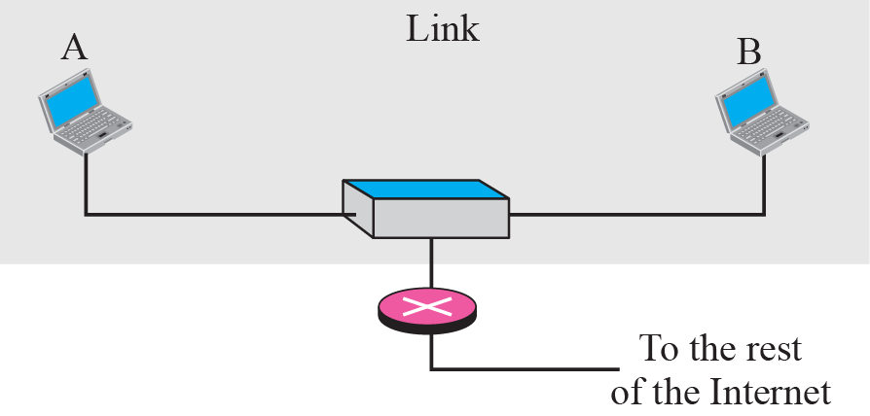
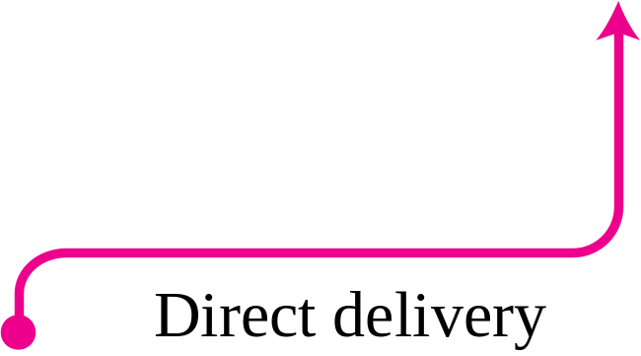
Figure 6.1 Direct delivery

Slide 7
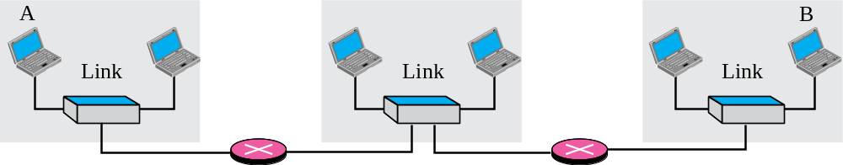
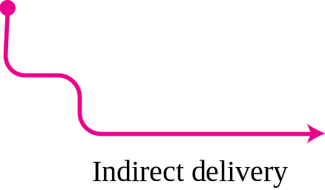
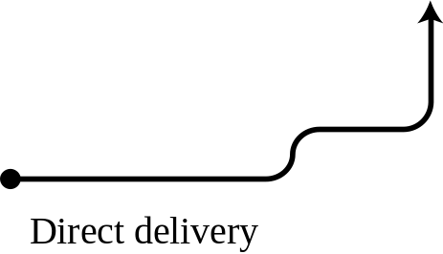

Figure 6.2 Indirect delivery

Slide 8
6-2 FORWARDING
Forwarding means to place the packet in its route to its destination. Since the Internet today is made of a combination of links (networks), forwarding means to deliver the packet to the next hop (which can be the final destination or the intermediate connecting device). Although the IP protocol was originally designed as a connectionless protocol, today the tendency is to use IP as a connection-oriented protocol.

Slide 9
Topics Discussed in the Section
Forwarding Based on Destination Address
Forwarding Based on Label

Slide 10
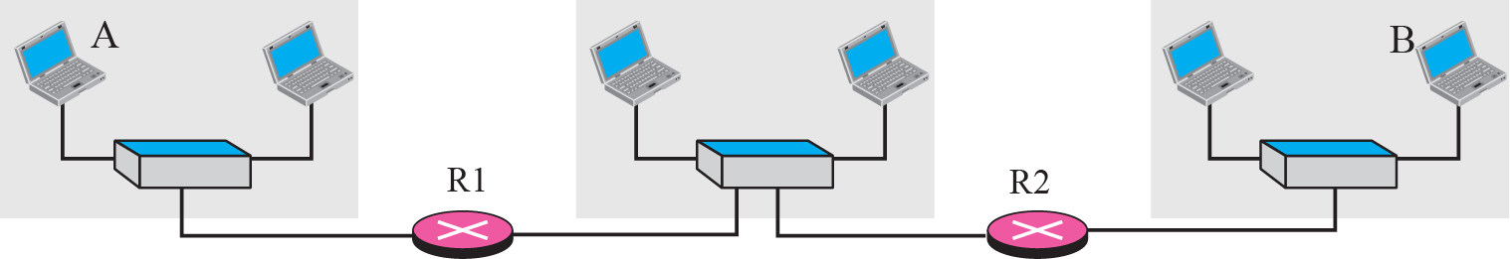
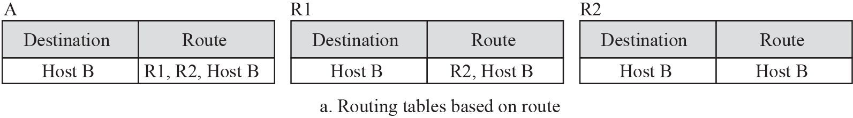
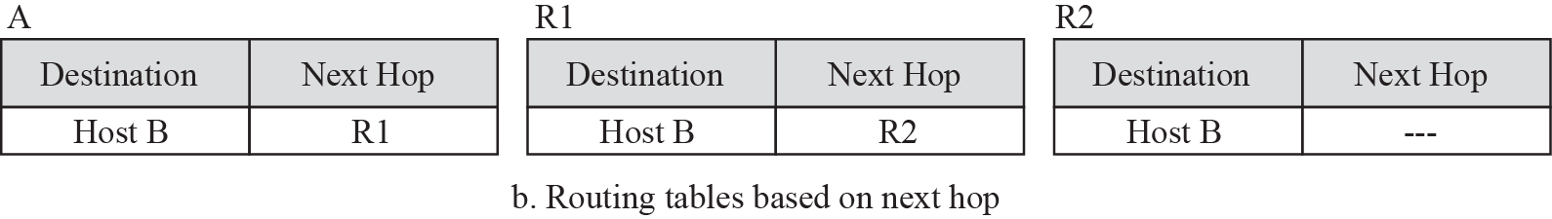
Figure 6.3 Next-hop method

Slide 11
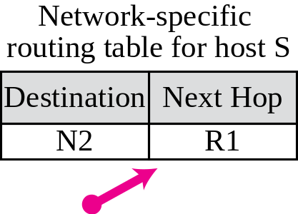
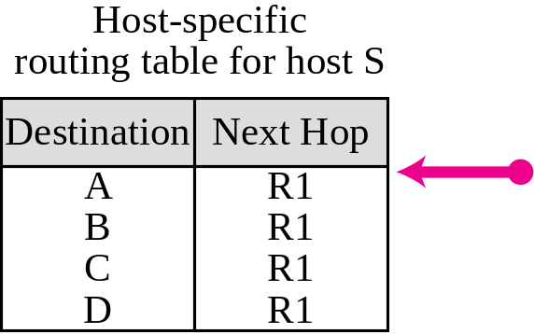
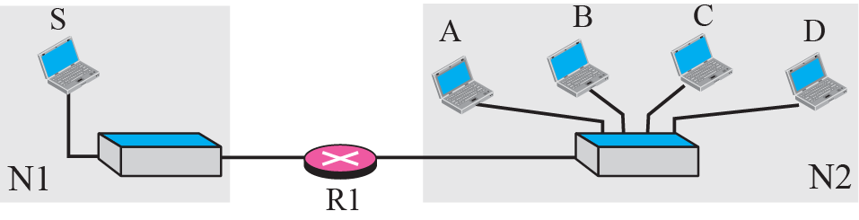
Figure 6.4 Network-specific method
Notes:
Host-specific
routing table for host SNext HopR1
R1
R1
R1DestinationA
B
C

Slide 12
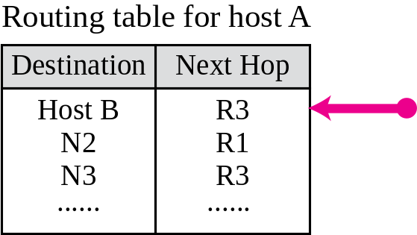
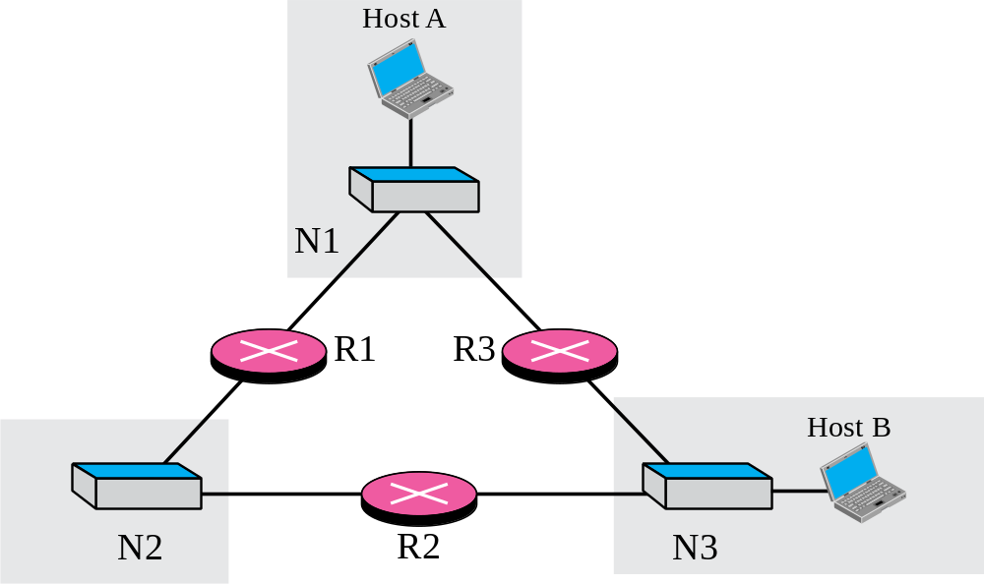
Figure 6.5 Host-specific routing

Slide 13
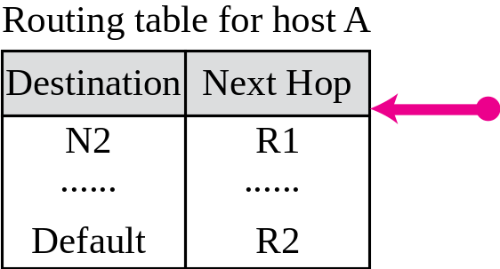
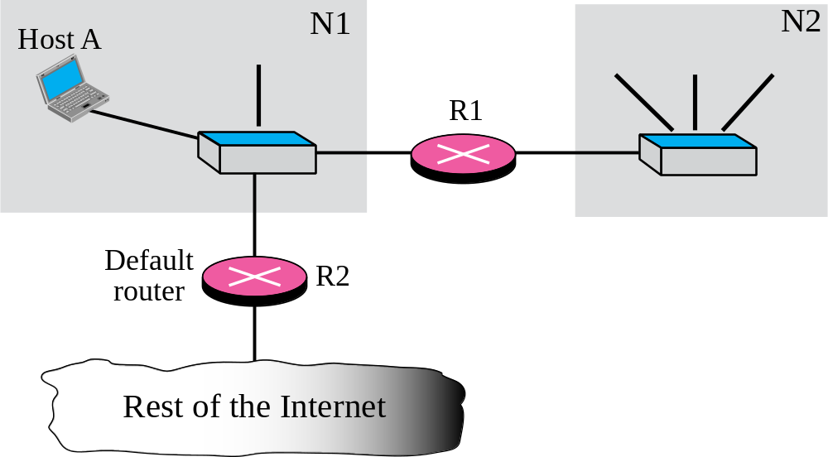
Figure 6.6 Default routing

Slide 14
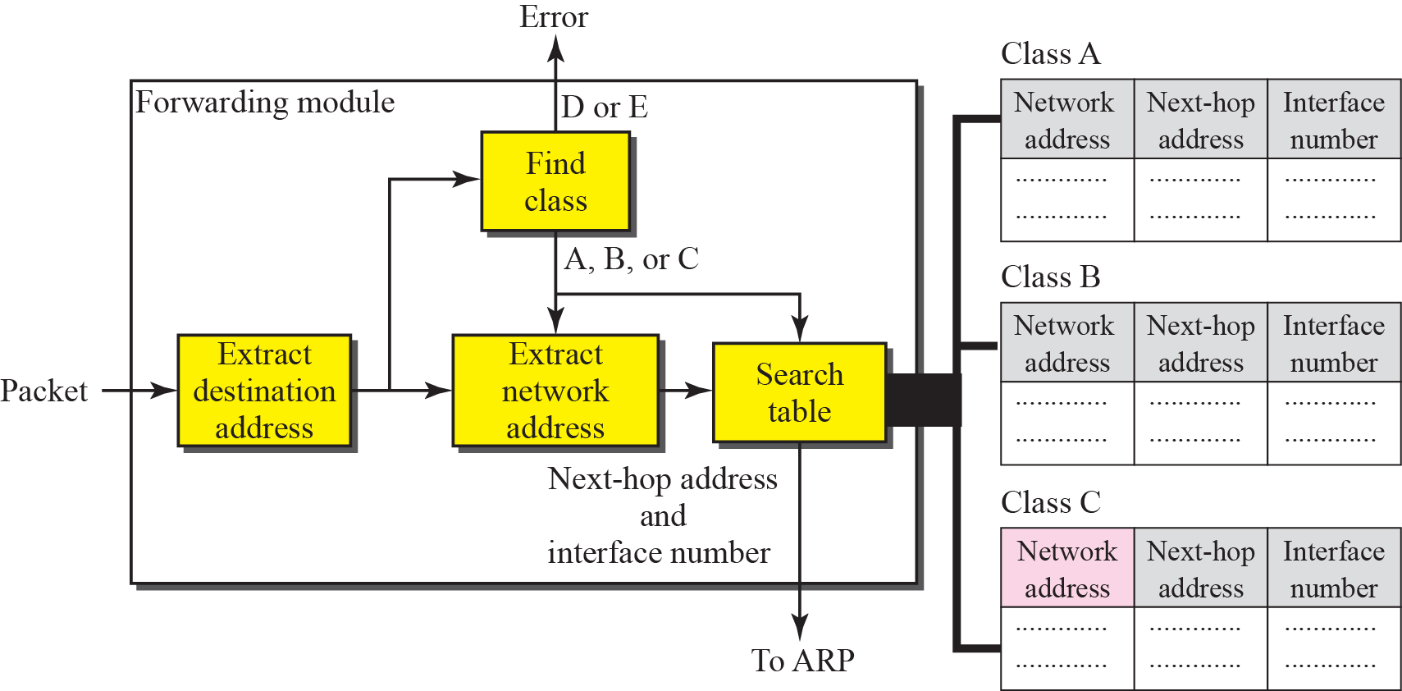
Figure 6.7 Simplified forwarding module in classful address without subnetting

Slide 15
Example 6.1
Figure 6.8 shows an imaginary part of the Internet. Show the routing tables for router R1.
Solution
Figure 6.9 shows the three tables used by router R1. Note that some entries in the next-hop address column are empty because in these cases, the destination is in the same network to which the router is connected (direct delivery). In these cases, the next-hop address used by ARP is simply the destination address of the packet as we will see in Chapter 8.

Slide 16
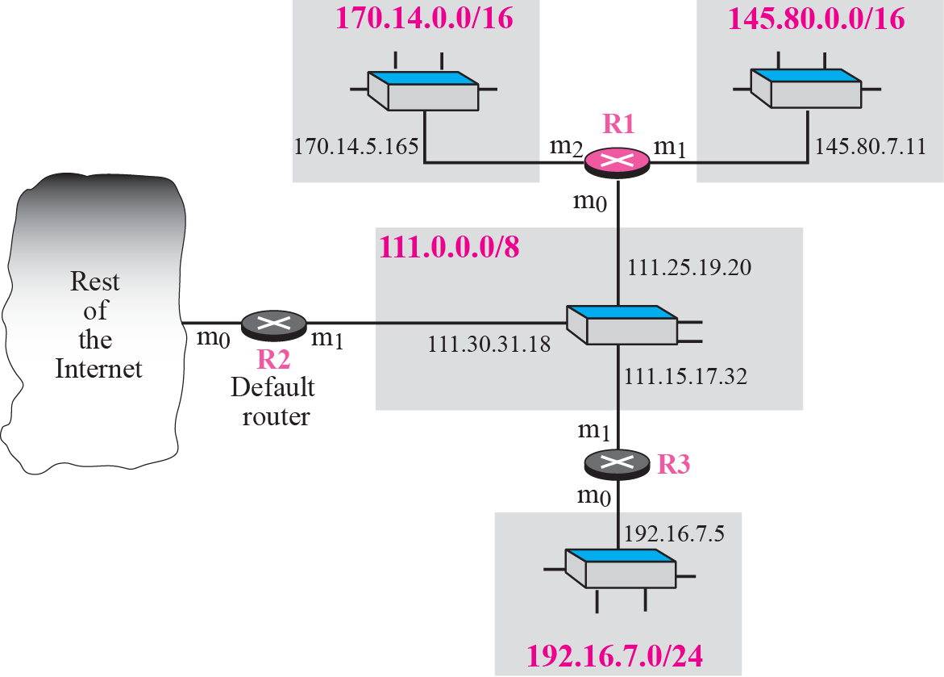
Figure 6.8 Configuration for routing, Example 6.1

Slide 17
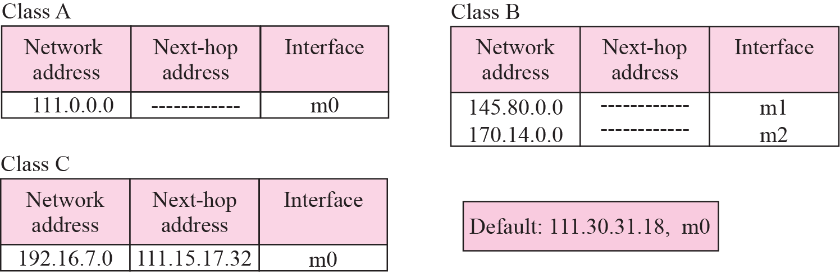
Figure 6.9 Tables for Example 6.1

Slide 18
Example 6.2
Router R1 in Figure 6.8 receives a packet with destination address 192.16.7.14. Show how the packet is forwarded.
Solution
The destination address is
11000000 00010000 000001110 0001110.
A copy of the address is shifted 28 bits to the right. The result is
00000000 00000000 00000000 00001100 or 12.
The destination network is class C. The network address is extracted by masking off the leftmost 24 bits of the destination address; the result is 192.16.7.0. The table for Class C is searched. The network address is found in the first row. The next-hop address 111.15.17.32. and the interface m0 are passed to ARP (see Chapter 8).

Slide 19
Example 6.3
Router R1 in Figure 6.8 receives a packet with destination address 167.24.160.5. Show how the packet is forwarded.
Solution
The destination address in binary is
10100111 00011000 10100000 00000101.
A copy of the address is shifted 28 bits to the right. The result is
00000000 00000000 00000000 00001010 or 10.
The class is B. The network address can be found by masking off 16 bits of the destination address, the result is 167.24.0.0. The table for Class B is searched. No matching network address is found. The packet needs to be forwarded to the default router (the network is somewhere else in the Internet). The next-hop address 111.30.31.18 and the interface number m0 are passed to ARP.

Slide 20
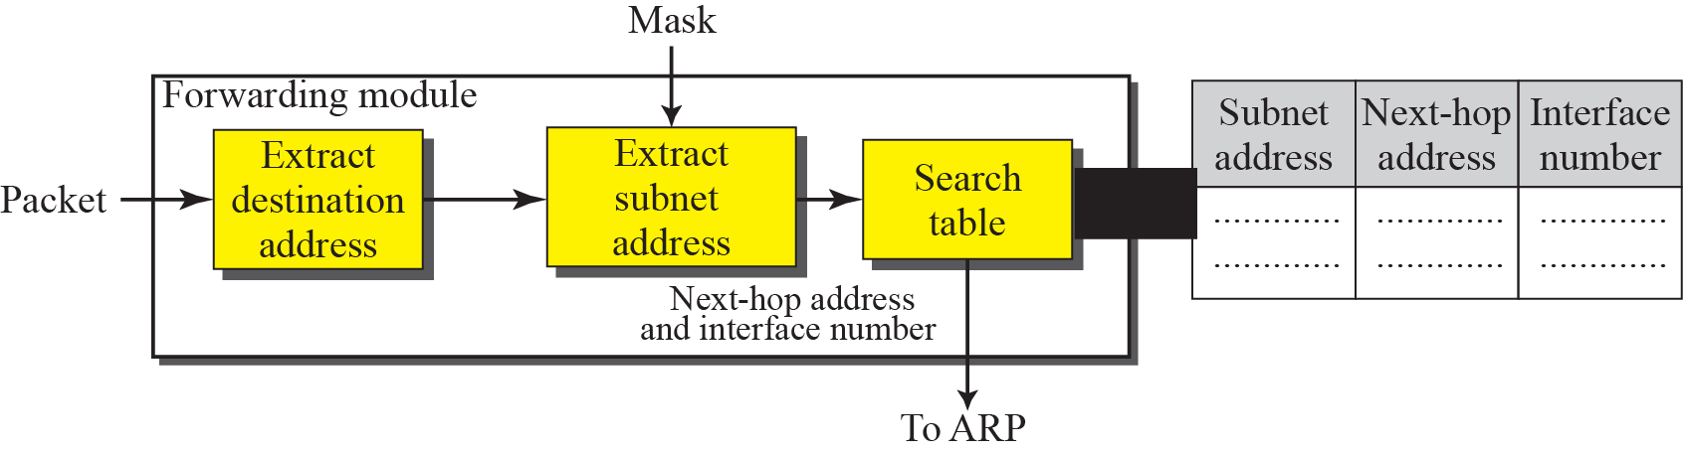
Figure 6.10 Simplified forwarding module in classful address with subnetting

Slide 21
Example 6.4
Figure 6.11 shows a router connected to four subnets. Note several points. First, the site address is 145.14.0.0/16 (a class B address). Every packet with destination address in the range 145.14.0.0 to 145.14.255.255 is delivered to the interface m4 and distributed to the final destination subnet by the router. Second, we have used the address x.y.z.t/n for the interface m4 because we do not know to which network this router is connected. Third, the table has a default entry for packets that are to be sent out of the site. The router is configured to apply the subnet mask /18 to any destination address.

Slide 22
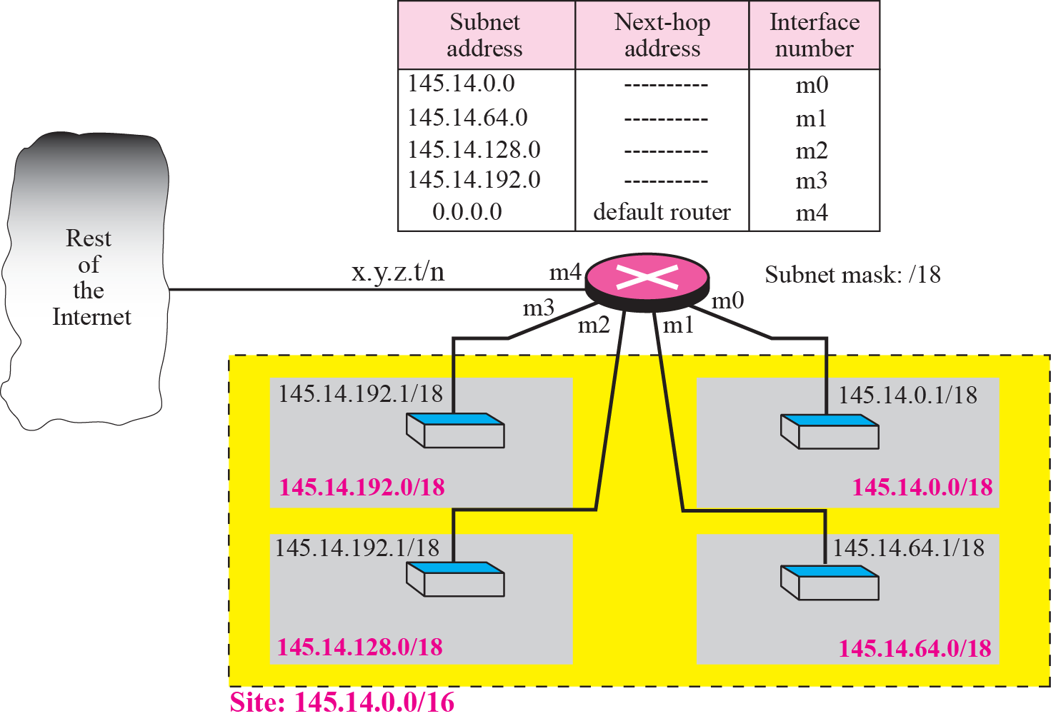
Figure 6.11 Configuration for Example 6.4

Slide 23
Example 6.5
The router in Figure 6.11 receives a packet with destination address 145.14.32.78. Show how the packet is forwarded.
Solution
The mask is /18. After applying the mask, the subnet address is 145.14.0.0. The packet is delivered to ARP (see Chapter 8) with the next-hop address 145.14.32.78 and the outgoing interface m0.

Slide 24
Example 6.6
A host in network 145.14.0.0 in Figure 6.11 has a packet to send to the host with address 7.22.67.91. Show how the packet
is routed.
Solution
The router receives the packet and applies the mask (/18). The network address is 7.22.64.0. The table is searched and the address is not found. The router uses the address of the default router (not shown in figure) and sends the packet to that router.

Slide 25

Note
In classful addressing we can have a routing table with three columns;
in classless addressing,
we need at least four columns.

Slide 26
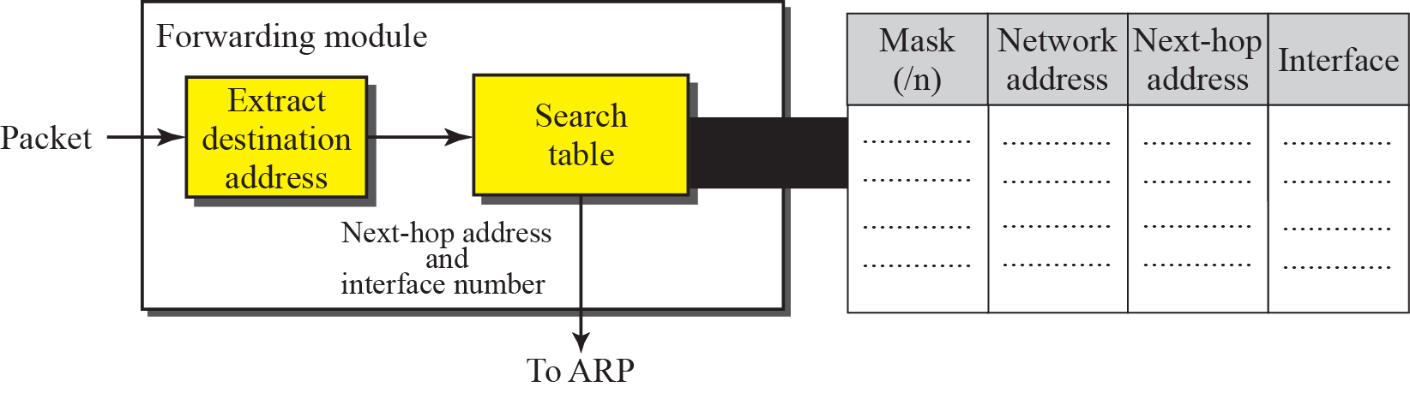
Figure 6.12 Simplified forwarding module in classless address

Slide 27
Example 6.7
Make a routing table for router R1 using the configuration in Figure 6.13.
Solution
Table 6.1 shows the corresponding table

Slide 28
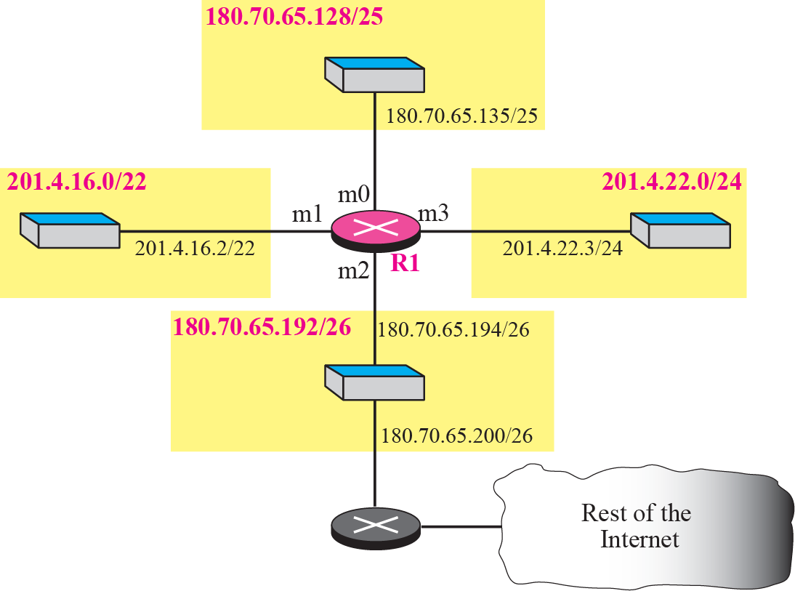
Figure 6.13 Configuration for Example 6.7

Slide 29
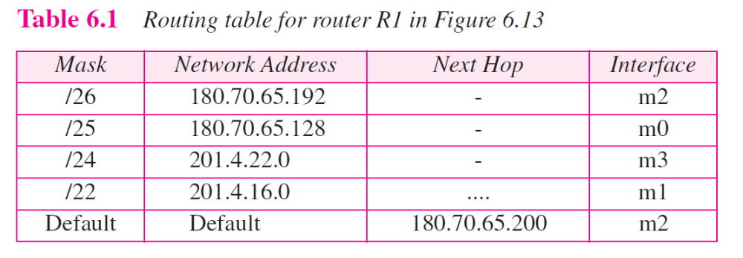

Slide 30
Example 6.8
Show the forwarding process if a packet arrives at R1 in Figure 6.13 with the destination address 180.70.65.140.
Solution
The router performs the following steps:
1. The first mask (/26) is applied to the destination address. The result is 180.70.65.128, which does not match the corresponding network address.
2. The second mask (/25) is applied to the destination address. The result is 180.70.65.128, which matches the
corresponding network address. The next-hop address (the destination address of the packet in this case) and the interface number m0 are passed to ARP (see Chapter 8) for further processing.

Slide 31
Example 6.9
Show the forwarding process if a packet arrives at R1 in Figure 6.13 with the destination address 201.4.22.35.
Solution
The router performs the following steps:
1. The first mask (/26) is applied to the destination address. The result is 201.4.22.0, which does not match the corresponding network address (row 1).
2. The second mask (/25) is applied to the destination address. The result is 201.4.22.0, which does not match the corresponding network address (row 2).
3. The third mask (/24) is applied to the destination address. The result is 201.4.22.0, which matches the corresponding network address.

Slide 32
Example 6.10
Show the forwarding process if a packet arrives at R1 in Figure 6.13 with the destination address 18.24.32.78.
Solution
This time all masks are applied to the destination address, but no matching network address is found. When it reaches the end of the table, the module gives the next-hop address 180.70.65.200 and interface number m2 to ARP (see Chapter 8). This is probably an outgoing package that needs to be sent, via the default router, to someplace else in the Internet.

Slide 33
Example 6.11
Now let us give a different type of example. Can we find the configuration of a router if we know only its routing table? The routing table for router R1 is given in Table 6.2. Can we draw its
topology?
Solution
We know some facts but we don’t have all for a definite topology. We know that router R1 has three interfaces: m0, m1, and m2. We know that there are three networks directly connected to router R1. We know that there are two networks indirectly connected to R1. There must be at least three other routers involved (see next-hop column). We do not know if network 140.6.12.64 is connected to router R3 directly or through a point-to-point network (WAN) and another router. Figure 6.14 shows our guessed topology.

Slide 34
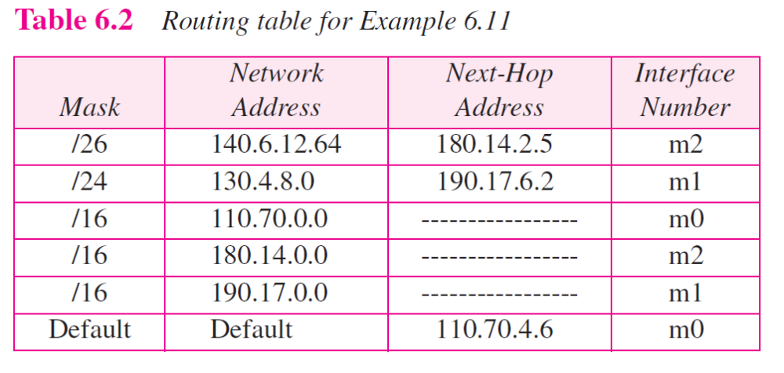

Slide 35
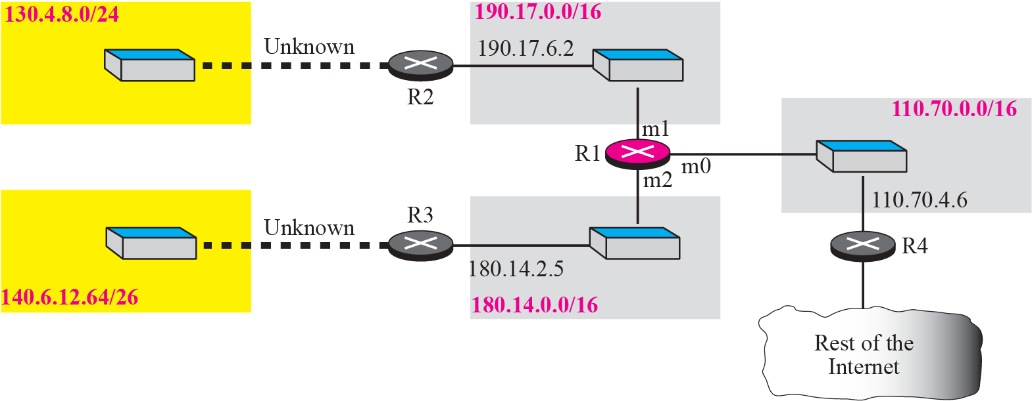
Figure 6.14 Guessed topology for Example 6.11

Slide 36
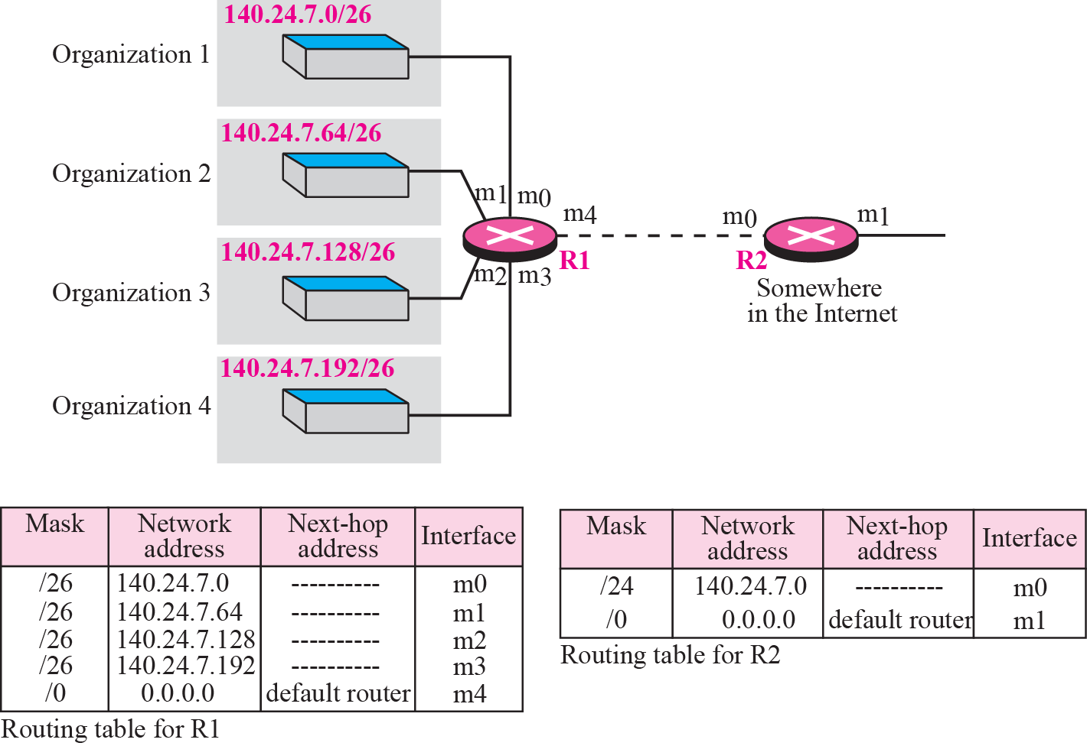
Figure 6.15 Address aggregation

Slide 37
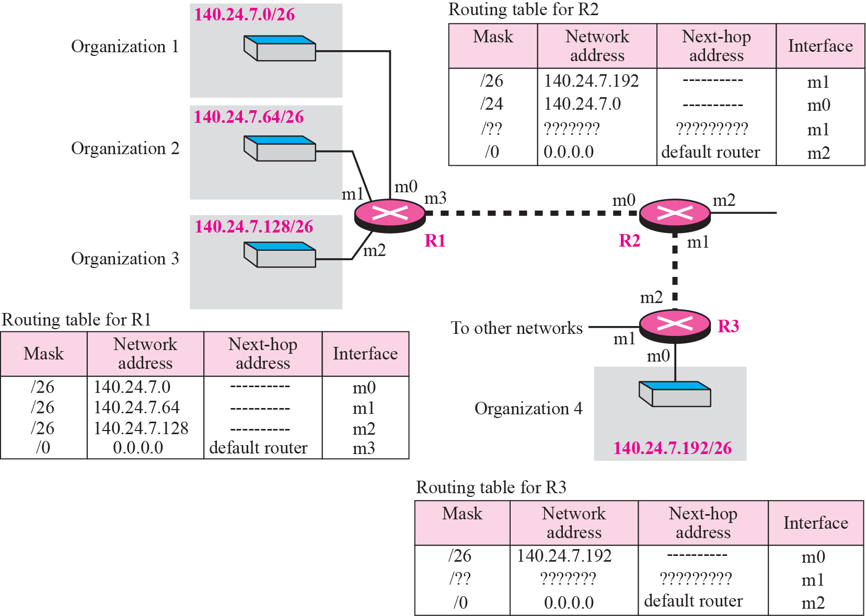
Figure 6.16 Longest mask matching

Slide 38
Example 6.12
As an example of hierarchical routing, let us consider Figure 6.17. A regional ISP is granted 16,384 addresses starting from 120.14.64.0. The regional ISP has decided to divide this block into 4 subblocks, each with 4096 addresses. Three of these subblocks are assigned to three local ISPs, the second subblock is reserved for future use. Note that the mask for each block is /20 because the original block with mask /18 is divided into 4 blocks.

Slide 39
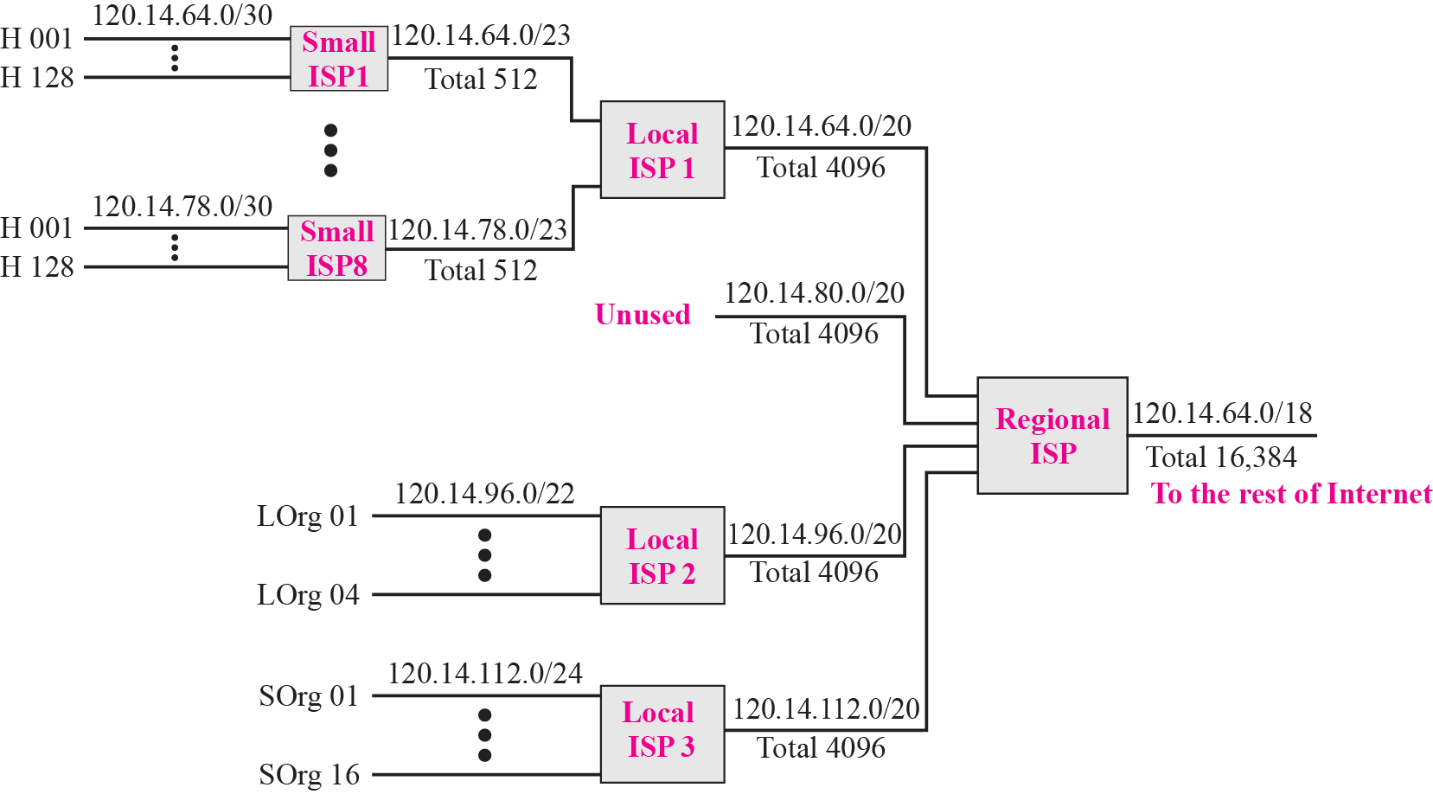
Figure 6.17 Hierarchical routing with ISPs

Slide 40
Example 6.13
Figure 6.18 shows a simple example of searching in a routing table using the longest match algorithm. Although there are some more efficient algorithms today, the principle is the same. When the forwarding algorithm gets the destination address of the packet, it needs to delve into the mask column. For each entry, it needs to apply the mask to find the destination network address. It then needs to check the network addresses in the table until it finds the match. The router then extracts the next hop address and the interface number to be delivered to the ARP protocol for delivery of the packet to the next hop.

Slide 41
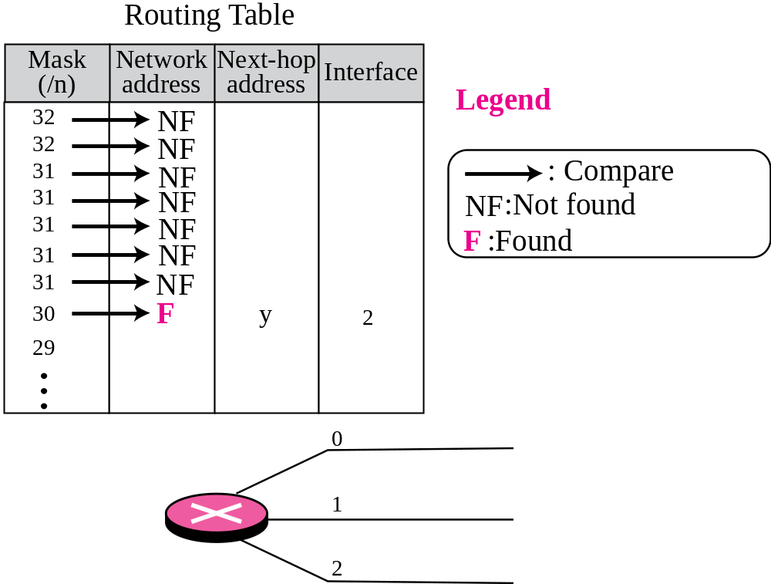
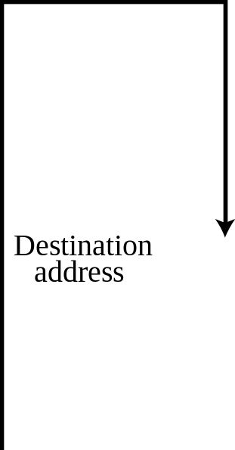
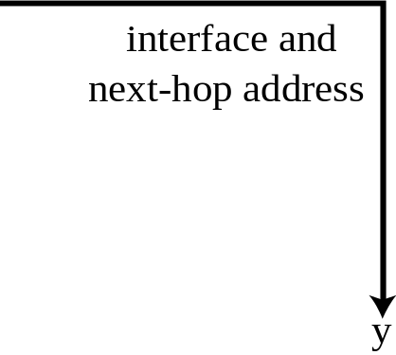

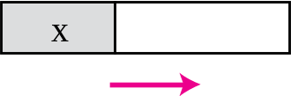
Figure 6.18 Example 6.13: Forwarding based on destination address

Slide 42
Example 6.14
Figure 6.19 shows a simple example of using a label to access a switching table. Since the labels are used as the index to the table, finding the information in the table is immediate.

Slide 43
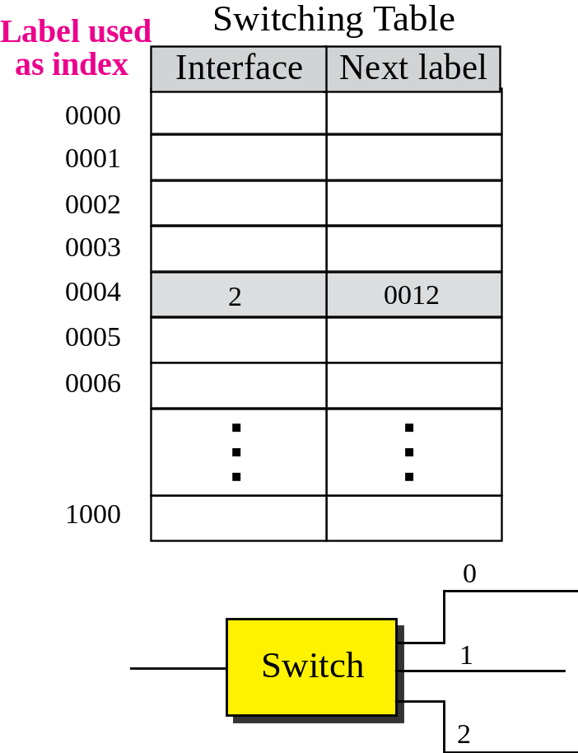
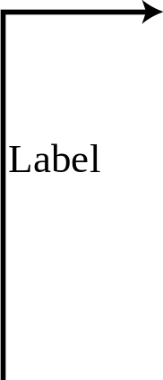
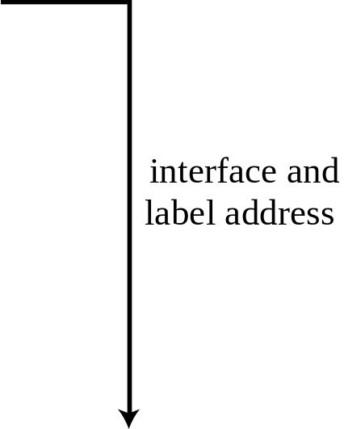

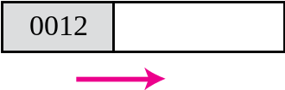
Figure 6.19 Example 6.14: Forwarding based on label
Notes:
interface and
label address interface and
label address 0012

Slide 44
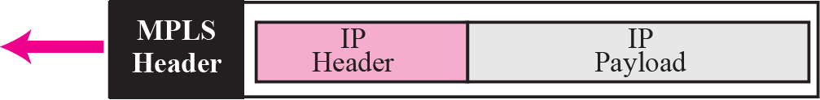
Figure 6.20 MPLS header added to an IP packet

Slide 45
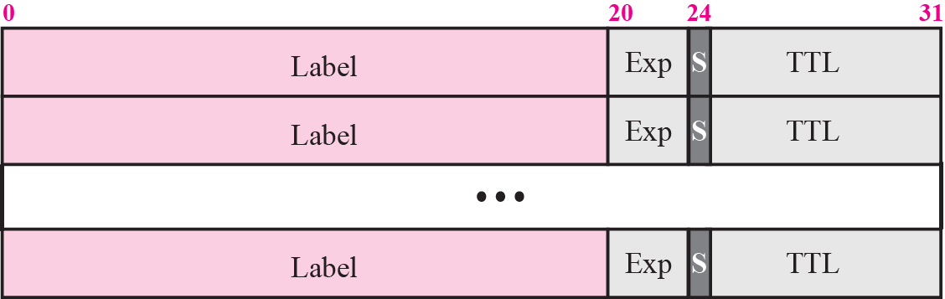
Figure 6.21 MPLS header made of stack of labels

Slide 46
6-3 STRUCTURE OF A ROUTER
In our discussion of forwarding and routing, we represented a router as a black box that accepts incoming packets from one of the input ports (interfaces), uses a routing table to find the output port from which the packet departs, and sends the packet from this output port. In this section we open the black box and look inside. However, our discussion won’t be very detailed; entire books have been written about routers. We just give an overview to the reader.

Slide 47
Topics Discussed in the Section
Components

Slide 48
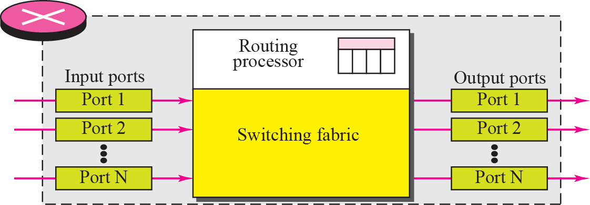
Figure 6.22 Router components

Slide 49
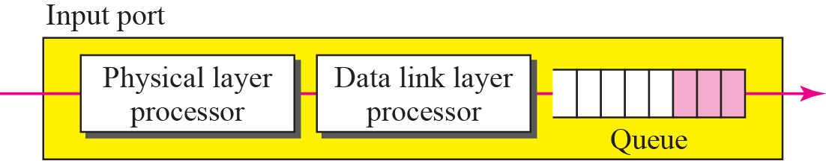
Figure 6.23 Input port

Slide 50
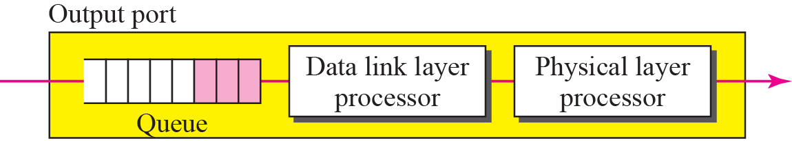
Figure 6.24 Output port

Slide 51
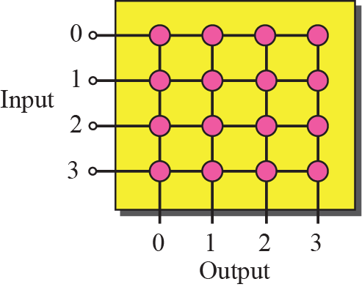
Figure 6.25 Crossbar switch

Slide 52
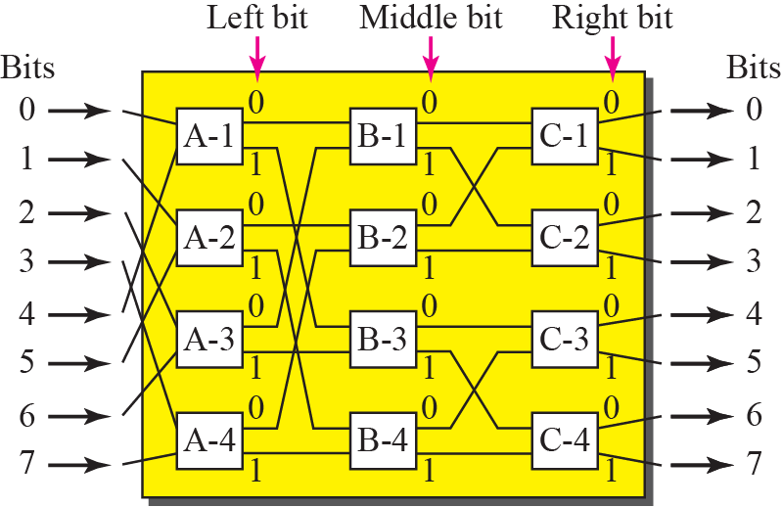
Figure 6.26 A banyan switch

Slide 53
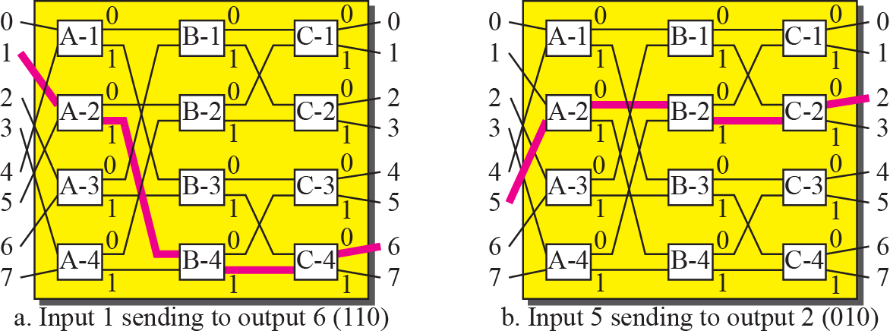
Figure 6.27 Examples of routing in a banyan switch

Slide 54
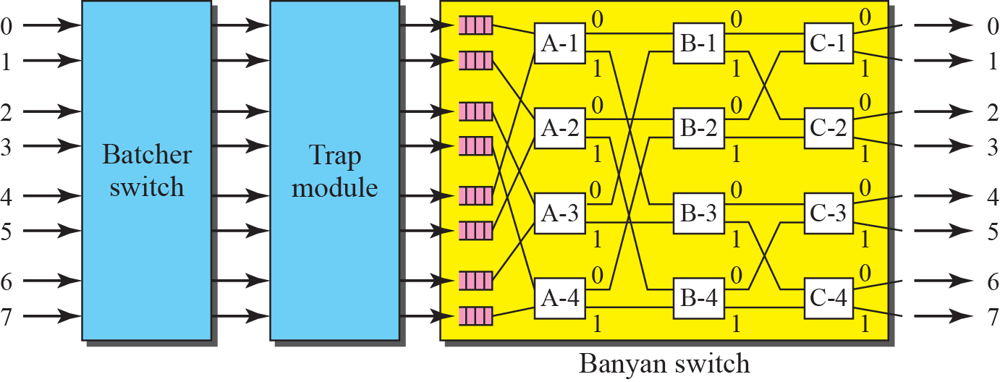
Figure 6.28 Batcher-banyan switch

